Slide 1
Chapter 7 - Arrays
Outline
7.1 Introduction
7.2 Arrays
7.3 Declaring and Allocating Arrays
7.4 Examples Using Arrays
7.4.1 Allocating an Array and Initializing Its Elements
7.4.2 Using an Initializer List to Initialize Elements of an Array
7.4.3 Calculating the Value to Store in Each Array Element
7.4.4 Summing the Elements of an Array
7.4.5 Using Histograms to Display Array Data Graphically
7.4.6 Using the Elements of an Array as Counters
7.4.7 Using Arrays to Analyze Survey Results
7.5 References and Reference Parameters
7.6 Passing Arrays to Methods
7.7 Sorting Arrays
7.8 Searching Arrays: Linear Search and Binary Search
7.8.1 Searching an Array with Linear Search
7.8.2 Searching a Sorted Array with Binary Search

Slide 2
Chapter 7 - Arrays
Outline
7.9 Multiple-Subscripted Arrays
7.10 (Optional Case Study) Thinking About Objects: Collaboration Among Objects

Slide 3
7.1 Introduction
Arrays
  Data structures
  Related data items of same type
  Remain same size once created
    Static entries

Slide 4
7.2 Arrays
Array
  Group of contiguous memory locations
    Each memory location has same name
    Each memory location has same type

Slide 5
Name of array (Note
that all elements of
this array have the
same name, c)
c[ 0 ]
-45
6
0
72
1543
-89
0
62
-3
1
6453
78
c[ 1 ]
c[ 2 ]
c[ 3 ]
c[ 4 ]
c[ 5 ]
c[ 6 ]
c[ 7 ]
c[ 8 ]
Position number (index
of subscript) of the
element within array c
c[ 9 ]
c[ 10 ]
c[ 11 ]
Fig. 7.1 A 12-element array.

Slide 6
7.2 Arrays (cont.)
Subscript
  Also called an index
  Position number in square brackets
  Must be integer or integer expression
  a = 5;
  b = 6;
  c[ a + b ] += 2;
    Adds 2 to c[ 11 ]
    Subscripted array name is an lvalue

Slide 7
7.2 Arrays (cont.)
Examine array c
  c is the array name
  c.length accesses array c’s length
  c has 12 elements ( c[0], c[1], … c[11] )
    The value of c[0] is –45
    The brackets ([]) are in highest level of precedence in Java

Slide 8
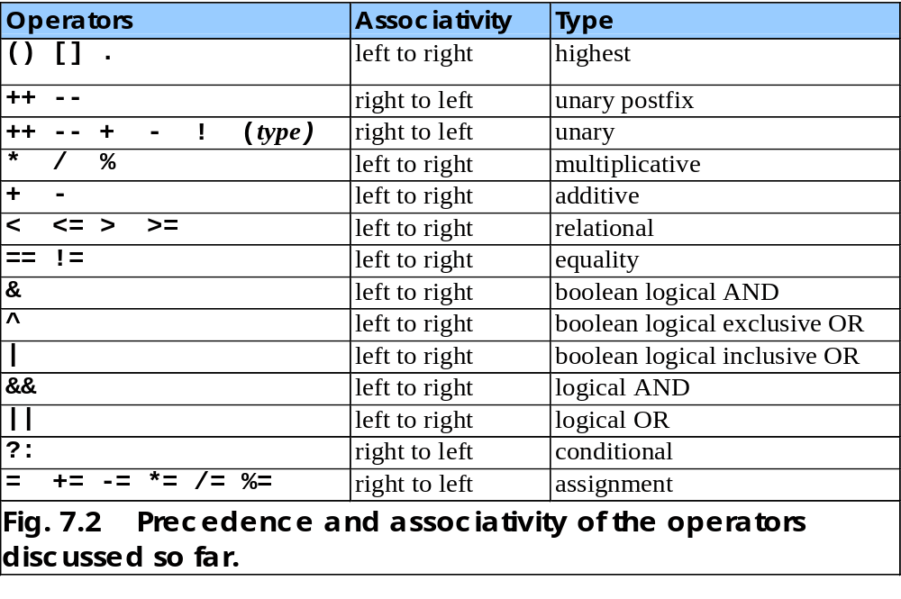

Slide 9
7.3 Declaring and Allocating Arrays
Declaring and Allocating arrays
  Arrays are objects that occupy memory
  Allocated dynamically with operator new
    int c[] = new int[ 12 ];
      Equivalent to
      int c[]; // declare array
      c = new int[ 12 ]; // allocate array
    We can allocate arrays of objects too
      String b[] = new String[ 100 ];

Slide 10
7.4 Examples Using Arrays
Declaring arrays
Allocating arrays
Initializing arrays
Manipulating array elements

Slide 11
7.4.1 Allocating an Array and Initializing Its Elements
Show how to
  Declare array
  Allocate array
  Initialize array elements

Slide 12
InitArray.java
Line 12
Declare array as an array of ints
Line 14
Allocate 10 ints for array; each int is initialized to 0 by default
Line 19 array.length returns length of array
Line 20 array[counter] returns int associated with index in array
1 // Fig. 7.3: InitArray.java
2 // Creating an array.
3
4 // Java extension packages
5 import javax.swing.*;
6
7 public class InitArray {
8
9 // main method begins execution of Java application
10 public static void main( String args[] )
11 {
12 int array[]; // declare reference to an array
13
14 array = new int[ 10 ]; // dynamically allocate array
15
16 String output = "Subscript\tValue\n";
17
18 // append each array element's value to String output
19 for ( int counter = 0; counter < array.length; counter++ )
20 output += counter + "\t" + array[ counter ] + "\n";
21
22 JTextArea outputArea = new JTextArea();
23 outputArea.setText( output );
24
25 JOptionPane.showMessageDialog( null, outputArea,
26 "Initializing an Array of int Values",
27 JOptionPane.INFORMATION_MESSAGE );
28
29 System.exit( 0 );
30 }
31 }
Declare array as an array of ints
Allocate 10 ints for array; each int is initialized to 0 by default
array.length returns length of array
array[counter] returns int associated with index in array

Slide 13
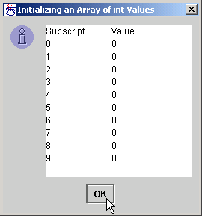
InitArray.java
Each int is initialized to 0 by default
Each int is initialized to 0 by default

Slide 14
7.4.2 Using an Initializer List to Initialize Elements of an Array
Initialize array elements
  Use initializer list
    Items enclosed in braces ({})
    Items in list separated by commas
    int n[] = { 10, 20, 30, 40, 50 };
      Creates a five-element array
      Subscripts of 0, 1, 2, 3, 4
  Do not need operator new

Slide 15
InitArray.java
Line 14
Declare array as an array of ints
Line 14
Compiler uses initializer list to allocate array
1 // Fig. 7.4: InitArray.java
2 // Initializing an array with a declaration.
3
4 // Java extension packages
5 import javax.swing.*;
6
7 public class InitArray {
8
9 // main method begins execution of Java application
10 public static void main( String args[] )
11 {
12 // initializer list specifies number of elements and
13 // value for each element
14 int array[] = { 32, 27, 64, 18, 95, 14, 90, 70, 60, 37 };
15
16 String output = "Subscript\tValue\n";
17
18 // append each array element's value to String output
19 for ( int counter = 0; counter < array.length; counter++ )
20 output += counter + "\t" + array[ counter ] + "\n";
21
22 JTextArea outputArea = new JTextArea();
23 outputArea.setText( output );
24
25 JOptionPane.showMessageDialog( null, outputArea,
26 "Initializing an Array with a Declaration",
27 JOptionPane.INFORMATION_MESSAGE );
28
29 System.exit( 0 );
30 }
31 }
Declare array as an array of ints
Compiler uses initializer list to allocate array

Slide 16
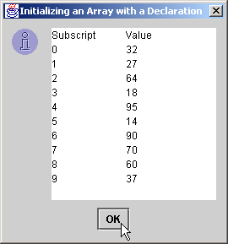
InitArray.java
Each array element corresponds to element in initializer list
Each array element corresponds to element in initializer list

Slide 17
7.4.3 Calculating the Value to Store in Each Array Element
Calculate value stored in each array element
  Initialize elements of 10-element array to even integers

Slide 18
InitArray.java
Line 13
Declare array as an array of ints
Line 15
Allocate 10 ints for array
Line 19
Use array subscript to assign array value
1 // Fig. 7.5: InitArray.java
2 // Initialize array with the even integers from 2 to 20.
3
4 // Java extension packages
5 import javax.swing.*;
6
7 public class InitArray {
8
9 // main method begins execution of Java application
10 public static void main( String args[] )
11 {
12 final int ARRAY_SIZE = 10;
13 int array[]; // reference to int array
14
15 array = new int[ ARRAY_SIZE ]; // allocate array
16
17 // calculate value for each array element
18 for ( int counter = 0; counter < array.length; counter++ )
19 array[ counter ] = 2 + 2 * counter;
20
21 String output = "Subscript\tValue\n";
22
23 for ( int counter = 0; counter < array.length; counter++ )
24 output += counter + "\t" + array[ counter ] + "\n";
25
26 JTextArea outputArea = new JTextArea();
27 outputArea.setText( output );
28
29 JOptionPane.showMessageDialog( null, outputArea,
30 "Initializing to Even Numbers from 2 to 20",
31 JOptionPane.INFORMATION_MESSAGE );
32
33 System.exit( 0 );
34 }
35 }
Declare array as an array of ints
Allocate 10 ints for array
Use array subscript to assign array value

Slide 19
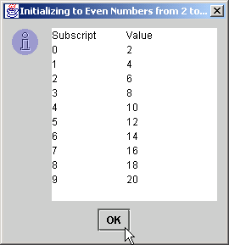
InitArray.java

Slide 20
7.4.4 Summing the Elements of an Array
Array elements
  Can represent a series of values
    We can sum these values

Slide 21
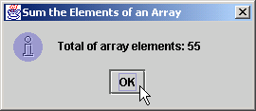
SumArray.java
Line 12
Declare array with initializer list
Line 17
Sum all array values
1 // Fig. 7.6: SumArray.java
2 // Total the values of the elements of an array.
3
4 // Java extension packages
5 import javax.swing.*;
6
7 public class SumArray {
8
9 // main method begins execution of Java application
10 public static void main( String args[] )
11 {
12 int array[] = { 1, 2, 3, 4, 5, 6, 7, 8, 9, 10 };
13 int total = 0;
14
15 // add each element's value to total
16 for ( int counter = 0; counter < array.length; counter++ )
17 total += array[ counter ];
18
19 JOptionPane.showMessageDialog( null,
20 "Total of array elements: " + total,
21 "Sum the Elements of an Array",
22 JOptionPane.INFORMATION_MESSAGE );
23
24 System.exit( 0 );
25 }
26 }
Declare array with initializer list
Sum all array values

Slide 22
7.4.5 Using Histograms to Display Array Data Graphically
Present array values graphically
  Histogram
    Plot each numeric value as bar of asterisks (*)

Slide 23
Histogram.java
Line 12
Declare array with initializer list
Line 23
For each array element, print associated number of asterisks
1 // Fig. 7.7: Histogram.java
2 // Histogram printing program.
3
4 // Java extension packages
5 import javax.swing.*;
6
7 public class Histogram {
8
9 // main method begins execution of Java application
10 public static void main( String args[] )
11 {
12 int array[] = { 19, 3, 15, 7, 11, 9, 13, 5, 17, 1 };
13
14 String output = "Element\tValue\tHistogram";
15
16 // for each array element, output a bar in histogram
17 for ( int counter = 0; counter < array.length; counter++ ) {
18 output +=
19 "\n" + counter + "\t" + array[ counter ] + "\t";
20
21 // print bar of asterisks
22 for ( int stars = 0; stars < array[ counter ]; stars++ )
23 output += "*";
24 }
25
26 JTextArea outputArea = new JTextArea();
27 outputArea.setText( output );
28
29 JOptionPane.showMessageDialog( null, outputArea,
30 "Histogram Printing Program",
31 JOptionPane.INFORMATION_MESSAGE );
32
33 System.exit( 0 );
34 }
35 }
Declare array with initializer list
For each array element, print associated number of asterisks

Slide 24
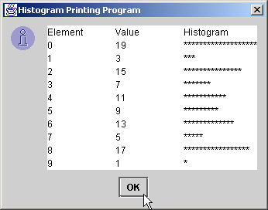
Histogram.java

Slide 25
7.4.6 Using the Elements of an Array as Counters
Use series of counters to summarize data
  Array can store these counters

Slide 26
RollDie.java
Line 12
Declare frequency as array of 7 ints
Lines 15-16
Generate 6000 random integers in range 1-6
Line 19
Increment frequency values at index associated with random number
1 // Fig. 7.8: RollDie.java
2 // Roll a six-sided die 6000 times
3
4 // Java extension packages
5 import javax.swing.*;
6
7 public class RollDie {
8
9 // main method begins execution of Java application
10 public static void main( String args[] )
11 {
12 int face, frequency[] = new int[ 7 ];
13
14 // roll die 6000 times
15 for ( int roll = 1; roll <= 6000; roll++ ) {
16 face = 1 + ( int ) ( Math.random() * 6 );
17
18 // use face value as subscript for frequency array
19 ++frequency[ face ];
20 }
21
22 String output = "Face\tFrequency";
23
24 // append frequencies to String output
25 for ( face = 1; face < frequency.length; face++ )
26 output += "\n" + face + "\t" + frequency[ face ];
27
28 JTextArea outputArea = new JTextArea();
29 outputArea.setText( output );
30
31 JOptionPane.showMessageDialog( null, outputArea,
32 "Rolling a Die 6000 Times",
33 JOptionPane.INFORMATION_MESSAGE );
34
Declare frequency as array of 7 ints
Generate 6000 random integers in range 1-6
Increment frequency values at index associated with random number

Slide 27
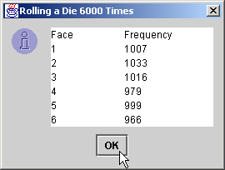
RollDie.java
35 System.exit( 0 );
36 }
37 }

Slide 28
7.4.7 Using Arrays to Analyze Survey Results
Problem statement
  40 students rate the quality of food
    1-10 Rating scale: 1 mean awful, 10 means excellent
  Place 40 responses in array of integers
  Summarize results

Slide 29
StudentPoll.java
Lines 12-15
Declare responses as array to store 40 responses
Line 16
Declare frequency as array of 11 int and ignore the first element
Lines 21-22
For each response, increment frequency values at index associated with that response
1 // Fig. 7.9: StudentPoll.java
2 // Student poll program
3
4 // Java extension packages
5 import javax.swing.*;
6
7 public class StudentPoll {
8
9 // main method begins execution of Java application
10 public static void main( String args[] )
11 {
12 int responses[] = { 1, 2, 6, 4, 8, 5, 9, 7, 8, 10,
13 1, 6, 3, 8, 6, 10, 3, 8, 2, 7,
14 6, 5, 7, 6, 8, 6, 7, 5, 6, 6,
15 5, 6, 7, 5, 6, 4, 8, 6, 8, 10 };
16 int frequency[] = new int[ 11 ];
17
18 // for each answer, select value of an element of
19 // responses array and use that value as subscript in
20 // frequency array to determine element to increment
21 for ( int answer = 0; answer < responses.length; answer++ )
22 ++frequency[ responses[ answer ] ];
23
24 String output = "Rating\tFrequency\n";
25
26 // append frequencies to String output
27 for ( int rating = 1; rating < frequency.length; rating++ )
28 output += rating + "\t" + frequency[ rating ] + "\n";
29
30 JTextArea outputArea = new JTextArea();
31 outputArea.setText( output );
32
33 JOptionPane.showMessageDialog( null, outputArea,
34 "Student Poll Program",
35 JOptionPane.INFORMATION_MESSAGE );
Declare responses as array to store 40 responses
Declare frequency as array of 11 int and ignore the first element
For each response, increment frequency values at index associated with that response

Slide 30
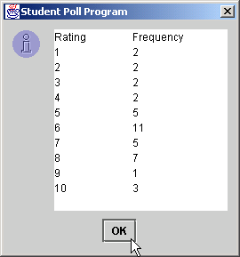
StudentPoll.java
36
37 System.exit( 0 );
38 }
39 }

Slide 31
7.4.7 Using Arrays to Analyze Survey Results (cont.)
Some additional points
  When looping through an array
    Subscript should never go below 0
    Subscript should be less than total number of array elements
  When invalid array reference occurs
    Java generates ArrayIndexOutOfBoundsException
      Chapter 14 discusses exception handling

Slide 32
7.5 References and Reference Parameters
Two ways to pass arguments to methods
  Pass-by-value
    Copy of argument’s value is passed to called method
    In Java, every primitive is pass-by-value
  Pass-by-reference
    Caller gives called method direct access to caller’s data
    Called method can manipulate this data
    Improved performance over pass-by-value
    In Java, every object is pass-by-reference
      In Java, arrays are objects
        Therefore, arrays are passed to methods by reference

Slide 33
7.6 Passing Arrays to Methods
To pass array argument to a method
  Specify array name without brackets
    Array hourlyTemperatures is declared as
    int hourlyTemperatures = new int[ 24 ];
    The method call
    modifyArray( hourlyTemperatures );
    Passes array hourlyTemperatures to method modifyArray

Slide 34
PassArray.java
Line 19
Declare 5-int array with initializer list
Line 29
Pass array by reference to method modifyArray
1 // Fig. 7.10: PassArray.java
2 // Passing arrays and individual array elements to methods
3
4 // Java core packages
5 import java.awt.Container;
6
7 // Java extension packages
8 import javax.swing.*;
9
10 public class PassArray extends JApplet {
11
12 // initialize applet
13 public void init()
14 {
15 JTextArea outputArea = new JTextArea();
16 Container container = getContentPane();
17 container.add( outputArea );
18
19 int array[] = { 1, 2, 3, 4, 5 };
20
21 String output =
22 "Effects of passing entire array by reference:\n" +
23 "The values of the original array are:\n";
24
25 // append original array elements to String output
26 for ( int counter = 0; counter < array.length; counter++ )
27 output += " " + array[ counter ];
28
29 modifyArray( array ); // array passed by reference
30
31 output += "\n\nThe values of the modified array are:\n";
32
33 // append modified array elements to String output
34 for ( int counter = 0; counter < array.length; counter++ )
35 output += " " + array[ counter ];
Declare 5-int array with initializer list
Pass array by reference to method modifyArray

Slide 35
PassArray.java
Line 42
Pass array[3] by value to method modifyElement
Lines 50-54
Method modifyArray manipulates the array directly
Lines 57-60
Method modifyElement manipulates a primitive’s copy
Lines 59
The original primitive is left unmodified
36
37 output += "\n\nEffects of passing array " +
38 "element by value:\n" +
39 "a[3] before modifyElement: " + array[ 3 ];
40
41 // attempt to modify array[ 3 ]
42 modifyElement( array[ 3 ] );
43
44 output += "\na[3] after modifyElement: " + array[ 3 ];
45 outputArea.setText( output );
46
47 } // end method init
48
49 // multiply each element of an array by 2
50 public void modifyArray( int array2[] )
51 {
52 for ( int counter = 0; counter < array2.length; counter++ )
53 array2[ counter ] *= 2;
54 }
55
56 // multiply argument by 2
57 public void modifyElement( int element )
58 {
59 element *= 2;
60 }
61
62 } // end class PassArray
Pass array[3] by value to method modifyElement
Method modifyArray manipulates the array directly
Method modifyElement manipulates a primitive’s copy
The original primitive is left unmodified

Slide 36
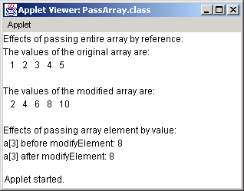
PassArray.java
The object passed-by-reference is modified
The primitive passed-by-value is unmodified
The object passed-by-reference is modified
The primitive passed-by-value is unmodified

Slide 37
7.7 Sorting Arrays
Sorting data
  Attracted intense research in computer-science field
  Bubble sort
    Smaller values “bubble” their way to top of array
    Larger values “sink” to bottom of array
    Use nested loops to make several passes through array
      Each pass compares successive pairs of elements
        Pairs are left along if increasing order (or equal)
        Pairs are swapped if decreasing order

Slide 38
BubbleSort.java
Line 19
Declare 10-int array with initializer list
Line 27
Pass array by reference to method bubbleSort to sort array
1 // Fig. 7.11: BubbleSort.java
2 // Sort an array's values into ascending order.
3
4 // Java core packages
5 import java.awt.*;
6
7 // Java extension packages
8 import javax.swing.*;
9
10 public class BubbleSort extends JApplet {
11
12 // initialize applet
13 public void init()
14 {
15 JTextArea outputArea = new JTextArea();
16 Container container = getContentPane();
17 container.add( outputArea );
18
19 int array[] = { 2, 6, 4, 8, 10, 12, 89, 68, 45, 37 };
20
21 String output = "Data items in original order\n";
22
23 // append original array values to String output
24 for ( int counter = 0; counter < array.length; counter++ )
25 output += " " + array[ counter ];
26
27 bubbleSort( array ); // sort array
28
29 output += "\n\nData items in ascending order\n";
30
31 // append sorted\ array values to String output
32 for ( int counter = 0; counter < array.length; counter++ )
33 output += " " + array[ counter ];
34
Declare 10-int array with initializer list
Pass array by reference to method bubbleSort to sort array

Slide 39
BubbleSort.java
Line 39
Method bubbleSort receives array reference as parameter
Lines 42-47
Use loop and nested loop to make passes through array
Lines 51-52
If pairs are in decreasing order, invoke method swap to swap pairs
Lines 61-68
Method swap swaps two values in array reference
35 outputArea.setText( output );
36 }
37
38 // sort elements of array with bubble sort
39 public void bubbleSort( int array2[] )
40 {
41 // loop to control number of passes
42 for ( int pass = 1; pass < array2.length; pass++ ) {
43
44 // loop to control number of comparisons
45 for ( int element = 0;
46 element < array2.length - 1;
47 element++ ) {
48
49 // compare side-by-side elements and swap them if
50 // first element is greater than second element
51 if ( array2[ element ] > array2[ element + 1 ] )
52 swap( array2, element, element + 1 );
53
54 } // end loop to control comparisons
55
56 } // end loop to control passes
57
58 } // end method bubbleSort
59
60 // swap two elements of an array
61 public void swap( int array3[], int first, int second )
62 {
63 int hold; // temporary holding area for swap
64
65 hold = array3[ first ];
66 array3[ first ] = array3[ second ];
67 array3[ second ] = hold;
68 }
Method bubbleSort receives array reference as parameter
Use loop and nested loop to make passes through array
If pairs are in decreasing order, invoke method swap to swap pairs
Method swap swaps two values in array reference

Slide 40
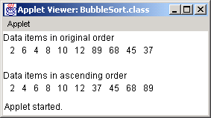
BubbleSort.java
69
70 } // end class BubbleSort

Slide 41
7.8 Searching Arrays: Linear Search and Binary Search
Searching
  Finding elements in large amounts of data
    Determine whether array contains value matching key value
  Linear searching
  Binary searching

Slide 42
7.8.1 Searching an Array with Linear Search
Linear search
  Compare each array element with search key
    If search key found, return element subscript
    If search key not found, return –1 (invalid subscript)
  Works best for small or unsorted arrays
  Inefficient for larger arrays

Slide 43
LinearSearch.java
Line 16
Declare array of ints
1 // Fig. 7.12: LinearSearch.java
2 // Linear search of an array
3
4 // Java core packages
5 import java.awt.*;
6 import java.awt.event.*;
7
8 // Java extension packages
9 import javax.swing.*;
10
11 public class LinearSearch extends JApplet
12 implements ActionListener {
13
14 JLabel enterLabel, resultLabel;
15 JTextField enterField, resultField;
16 int array[];
17
18 // set up applet's GUI
19 public void init()
20 {
21 // get content pane and set its layout to FlowLayout
22 Container container = getContentPane();
23 container.setLayout( new FlowLayout() );
24
25 // set up JLabel and JTextField for user input
26 enterLabel = new JLabel( "Enter integer search key" );
27 container.add( enterLabel );
28
29 enterField = new JTextField( 10 );
30 container.add( enterField );
31
32 // register this applet as enterField's action listener
33 enterField.addActionListener( this );
34
Declare array of ints

Slide 44
LinearSearch.java
Lines 44-47
Allocate 100 ints for array and populate array with even ints
Line 55
Loop through array
Lines 58-59
If array element at subscript matches search key, return subscript
Line 65
Invoked when user presses Enter
35 // set up JLabel and JTextField for displaying results
36 resultLabel = new JLabel( "Result" );
37 container.add( resultLabel );
38
39 resultField = new JTextField( 20 );
40 resultField.setEditable( false );
41 container.add( resultField );
42
43 // create array and populate with even integers 0 to 198
44 array = new int[ 100 ];
45
46 for ( int counter = 0; counter < array.length; counter++ )
47 array[ counter ] = 2 * counter;
48
49 } // end method init
50
51 // Search array for specified key value
52 public int linearSearch( int array2[], int key )
53 {
54 // loop through array elements
55 for ( int counter = 0; counter < array2.length; counter++ )
56
57 // if array element equals key value, return location
58 if ( array2[ counter ] == key )
59 return counter;
60
61 return -1; // key not found
62 }
63
64 // obtain user input and call method linearSearch
65 public void actionPerformed( ActionEvent actionEvent )
66 {
67 // input also can be obtained with enterField.getText()
68 String searchKey = actionEvent.getActionCommand();
69
Allocate 100 ints for array and populate array with even ints
Loop through array
If array element at subscript matches search key, return subscript
Invoked when user presses Enter

Slide 45
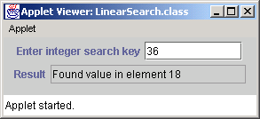
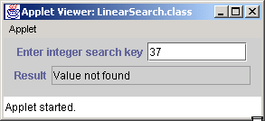
LinearSearch.java
Lines 73-74
Invoke method linearSearch, using array and search key as arguments
70 // Array a is passed to linearSearch even though it
71 // is an instance variable. Normally an array will
72 // be passed to a method for searching.
73 int element =
74 linearSearch( array, Integer.parseInt( searchKey ) );
75
76 // display search result
77 if ( element != -1 )
78 resultField.setText( "Found value in element " +
79 element );
80 else
81 resultField.setText( "Value not found" );
82 }
83
84 } // end class LinearSearch
Invoke method linearSearch, using array and search key as arguments

Slide 46
7.8.2 Searching a Sorted Array with Binary Search
Binary search
  Efficient for large, sorted arrays
  Eliminates half of the elements in search through each pass
    Compare middle array element to search key
      If element equals key
        Return array subscript
      If element is less than key
        Repeat search on first half of array
      If element is greater then key
        Repeat search on second half of array
      Continue search until
        element equals search key (success)
        Search contains one element not equal to key (failure)

Slide 47
BinarySearch.java
Line 19
Declare array of ints
1 // Fig. 7.13: BinarySearch.java
2 // Binary search of an array
3
4 // Java core packages
5 import java.awt.*;
6 import java.awt.event.*;
7 import java.text.*;
8
9 // Java extension packages
10 import javax.swing.*;
11
12 public class BinarySearch extends JApplet
13 implements ActionListener {
14
15 JLabel enterLabel, resultLabel;
16 JTextField enterField, resultField;
17 JTextArea output;
18
19 int array[];
20 String display = "";
21
22 // set up applet's GUI
23 public void init()
24 {
25 // get content pane and set its layout to FlowLayout
26 Container container = getContentPane();
27 container.setLayout( new FlowLayout() );
28
29 // set up JLabel and JTextField for user input
30 enterLabel = new JLabel( "Enter integer search key" );
31 container.add( enterLabel );
32
33 enterField = new JTextField( 10 );
34 container.add( enterField );
35
Declare array of ints

Slide 48
BinarySearch.java
Lines 53-56
Allocate 15 ints for array and populate array with even ints
Line 61
Invoked when user presses Enter
36 // register this applet as enterField's action listener
37 enterField.addActionListener( this );
38
39 // set up JLabel and JTextField for displaying results
40 resultLabel = new JLabel( "Result" );
41 container.add( resultLabel );
42
43 resultField = new JTextField( 20 );
44 resultField.setEditable( false );
45 container.add( resultField );
46
47 // set up JTextArea for displaying comparison data
48 output = new JTextArea( 6, 60 );
49 output.setFont( new Font( "Monospaced", Font.PLAIN, 12 ) );
50 container.add( output );
51
52 // create array and fill with even integers 0 to 28
53 array = new int[ 15 ];
54
55 for ( int counter = 0; counter < array.length; counter++ )
56 array[ counter ] = 2 * counter;
57
58 } // end method init
59
60 // obtain user input and call method binarySearch
61 public void actionPerformed( ActionEvent actionEvent )
62 {
63 // input also can be obtained with enterField.getText()
64 String searchKey = actionEvent.getActionCommand();
65
66 // initialize display string for new search
67 display = "Portions of array searched\n";
68
Allocate 15 ints for array and populate array with even ints
Invoked when user presses Enter

Slide 49
BinarySearch.java
Lines 70-71
Invoke method binarySearch, using array and search key as arguments
Lines 102-103
If search key matches middle array element, return element subscript
69 // perform binary search
70 int element =
71 binarySearch( array, Integer.parseInt( searchKey ) );
72
73 output.setText( display );
74
75 // display search result
76 if ( element != -1 )
77 resultField.setText(
78 "Found value in element " + element );
79 else
80 resultField.setText( "Value not found" );
81
82 } // end method actionPerformed
83
84 // method to perform binary search of an array
85 public int binarySearch( int array2[], int key )
86 {
87 int low = 0; // low element subscript
88 int high = array.length - 1; // high element subscript
89 int middle; // middle element subscript
90
91 // loop until low subscript is greater than high subscript
92 while ( low <= high ) {
93
94 // determine middle element subscript
95 middle = ( low + high ) / 2;
96
97 // display subset of array elements used in this
98 // iteration of binary search loop
99 buildOutput( array2, low, middle, high );
100
101 // if key matches middle element, return middle location
102 if ( key == array[ middle ] )
103 return middle;
Invoke method binarySearch, using array and search key as arguments
If search key matches middle array element, return element subscript

Slide 50
BinarySearch.java
Lines 106-107
If search key is less than middle array element, repeat search on first array half
Lines 110-111
If search key is greater than middle array element, repeat search on second array half
Lines 120-121
Method build-Output displays array contents being searched
104
105 // if key less than middle element, set new high element
106 else if ( key < array[ middle ] )
107 high = middle - 1;
108
109 // key greater than middle element, set new low element
110 else
111 low = middle + 1;
112 }
113
114 return -1; // key not found
115
116 } // end method binarySearch
117
118 // build row of output showing subset of array elements
119 // currently being processed
120 void buildOutput( int array3[],
121 int low, int middle, int high )
122 {
123 // create 2-digit integer number format
124 DecimalFormat twoDigits = new DecimalFormat( "00" );
125
126 // loop through array elements
127 for ( int counter = 0; counter < array3.length;
128 counter++ ) {
129
130 // if counter outside current array subset, append
131 // padding spaces to String display
132 if ( counter < low || counter > high )
133 display += " ";
134
If search key is less than middle array element, repeat search on first array half
If search key is greater than middle array element, repeat search on second array half
Method buildOutput displays array contents being searched

Slide 51
BinarySearch.java
Line 139
Display an asterisk next to middle element
135 // if middle element, append element to String display
136 // followed by asterisk (*) to indicate middle element
137 else if ( counter == middle )
138 display +=
139 twoDigits.format( array3[ counter ] ) + "* ";
140
141 // append element to String display
142 else
143 display +=
144 twoDigits.format( array3[ counter ] ) + " ";
145
146 } // end for structure
147
148 display += "\n";
149
150 } // end method buildOutput
151
152 } // end class BinarySearch
Display an asterisk next to middle element

Slide 52
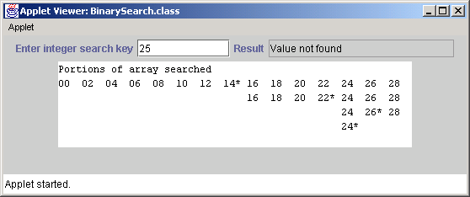
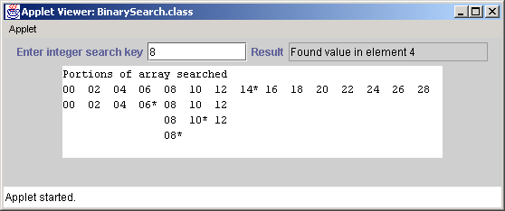
BinarySearch.java

Slide 53
7.9 Multiple-Subscripted Arrays
Multiple-subscripted arrays
  Tables with rows and columns
    Double-subscripted (two-dimensional) array
    Declaring double-subscripted array b[2][2]
    int b[][] = { { 1, 2 }, { 3, 4 } };
      1 and 2 initialize b[0][0] and b[0][1]
      3 and 4 initialize b[1][0] and b[1][1]
    int b[][] = { { 1, 2 }, { 3, 4, 5 } };
      row 0 contains elements 1 and 2
      row 1 contains elements 3, 4 and 5

Slide 54
7.9 Multiple-Subscripted Arrays (cont.)
Allocating multiple-subscripted arrays
  Can be allocated dynamically
    3-by-4 array
    int b[][];
    b = new int[ 3 ][ 4 ];
    Rows can have different number of columns
    int b[][];
    b = new int[ 2 ][ ]; // allocate rows
    b[ 0 ] = new int[ 5 ]; // allocate row 0
    b[ 1 ] = new int[ 3 ]; // allocate row 1

Slide 55
Column 0
Column 1
Column 2
Column 3
Row 0
a[ 0 ][ 0 ]
a[ 1 ][ 0 ]
a[ 2 ][ 0 ]
a[ 0 ][ 1 ]
a[ 1 ][ 1 ]
a[ 2 ][ 1 ]
a[ 0 ][ 2 ]
a[ 1 ][ 2 ]
a[ 2 ][ 2 ]
a[ 0 ][ 3 ]
a[ 1 ][ 3 ]
a[ 2 ][ 3 ]
Row 1
Row 2
Column subscript (or index)
Row Subscript (or index)
Array name
Fig. 7.14 A double-subscripted array with three rows and four columns.

Slide 56
InitArray.java
Line 20
Declare array1 with six initializers in two sublists
Line 21
Declare array2 with six initializers in three sublists
1 // Fig. 7.15: InitArray.java
2 // Initializing multidimensional arrays
3
4 // Java core packages
5 import java.awt.Container;
6
7 // Java extension packages
8 import javax.swing.*;
9
10 public class InitArray extends JApplet {
11 JTextArea outputArea;
12
13 // set up GUI and initialize applet
14 public void init()
15 {
16 outputArea = new JTextArea();
17 Container container = getContentPane();
18 container.add( outputArea );
19
20 int array1[][] = { { 1, 2, 3 }, { 4, 5, 6 } };
21 int array2[][] = { { 1, 2 }, { 3 }, { 4, 5, 6 } };
22
23 outputArea.setText( "Values in array1 by row are\n" );
24 buildOutput( array1 );
25
26 outputArea.append( "\nValues in array2 by row are\n" );
27 buildOutput( array2 );
28 }
29
30 // append rows and columns of an array to outputArea
31 public void buildOutput( int array[][] )
32 {
Declare array1 with six initializers in two sublists
Declare array2 with six initializers in three sublists

Slide 57
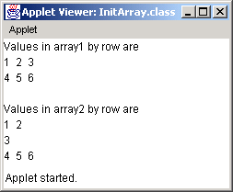
InitArray.java
Line 38 array[row].length returns number of columns associated with row subscript
Line 40
Use double-bracket notation to access double-subscripted array values
array[row].length returns number of columns associated with row subscript
33 // loop through array's rows
34 for ( int row = 0; row < array.length; row++ ) {
35
36 // loop through columns of current row
37 for ( int column = 0;
38 column < array[ row ].length;
39 column++ )
40 outputArea.append( array[ row ][ column ] + " " );
41
42 outputArea.append( "\n" );
43 }
44 }
45 }
Use double-bracket notation to access double-subscripted array values

Slide 58
DoubleArray.java
Lines 11-13
Declare grades as 3-by-4 array
Lines 11-13
Each row represents a student; each column represents an exam grade
1 // Fig. 7.16: DoubleArray.java
2 // Double-subscripted array example
3
4 // Java core packages
5 import java.awt.*;
6
7 // Java extension packages
8 import javax.swing.*;
9
10 public class DoubleArray extends JApplet {
11 int grades[][] = { { 77, 68, 86, 73 },
12 { 96, 87, 89, 81 },
13 { 70, 90, 86, 81 } };
14
15 int students, exams;
16 String output;
17 JTextArea outputArea;
18
19 // initialize instance variables
20 public void init()
21 {
22 students = grades.length; // number of students
23 exams = grades[ 0 ].length; // number of exams
24
25 // create JTextArea and attach to applet
26 outputArea = new JTextArea();
27 Container container = getContentPane();
28 container.add( outputArea );
29
30 // build output string
31 output = "The array is:\n";
32 buildString();
33
Declare grades as 3-by-4 array
Each row represents a student; each column represents an exam grade

Slide 59
DoubleArray.java
Lines 35-41
Determine minimum, maximum and average for each student
Lines 65-66
Use a nested loop to search for lowest grade in series
34 // call methods minimum and maximum
35 output += "\n\nLowest grade: " + minimum() +
36 "\nHighest grade: " + maximum() + "\n";
37
38 // call method average to calculate each student's average
39 for ( int counter = 0; counter < students; counter++ )
40 output += "\nAverage for student " + counter + " is " +
41 average( grades[ counter ] );
42
43 // change outputArea's display font
44 outputArea.setFont(
45 new Font( "Courier", Font.PLAIN, 12 ) );
46
47 // place output string in outputArea
48 outputArea.setText( output );
49 }
50
51 // find minimum grade
52 public int minimum()
53 {
54 // assume first element of grades array is smallest
55 int lowGrade = grades[ 0 ][ 0 ];
56
57 // loop through rows of grades array
58 for ( int row = 0; row < students; row++ )
59
60 // loop through columns of current row
61 for ( int column = 0; column < exams; column++ )
62
63 // Test if current grade is less than lowGrade.
64 // If so, assign current grade to lowGrade.
65 if ( grades[ row ][ column ] < lowGrade )
66 lowGrade = grades[ row ][ column ];
67
68 return lowGrade; // return lowest grade
Determine minimum, maximum and average for each student
Use a nested loop to search for lowest grade in series

Slide 60
DoubleArray.java
Lines 85-86
Use a nested loop to search for highest grade in series
Line 93
Method average takes array of student test results as parameter
Lines 98-99
Calculate sum of array elements
Line 102
Divide by number of elements to get average
69 }
70
71 // find maximum grade
72 public int maximum()
73 {
74 // assume first element of grages array is largest
75 int highGrade = grades[ 0 ][ 0 ];
76
77 // loop through rows of grades array
78 for ( int row = 0; row < students; row++ )
79
80 // loop through columns of current row
81 for ( int column = 0; column < exams; column++ )
82
83 // Test if current grade is greater than highGrade.
84 // If so, assign current grade to highGrade.
85 if ( grades[ row ][ column ] > highGrade )
86 highGrade = grades[ row ][ column ];
87
88 return highGrade; // return highest grade
89 }
90
91 // determine average grade for particular
92 // student (or set of grades)
93 public double average( int setOfGrades[] )
94 {
95 int total = 0; // initialize total
96
97 // sum grades for one student
98 for ( int count = 0; count < setOfGrades.length; count++ )
99 total += setOfGrades[ count ];
100
101 // return average of grades
102 return ( double ) total / setOfGrades.length;
103 }
Use a nested loop to search for highest grade in series
Method average takes array of student test results as parameter
Calculate sum of array elements
Divide by number of elements to get average

Slide 61
DoubleArray.java
104
105 // build output string
106 public void buildString()
107 {
108 output += " "; // used to align column heads
109
110 // create column heads
111 for ( int counter = 0; counter < exams; counter++ )
112 output += "[" + counter + "] ";
113
114 // create rows/columns of text representing array grades
115 for ( int row = 0; row < students; row++ ) {
116 output += "\ngrades[" + row + "] ";
117
118 for ( int column = 0; column < exams; column++ )
119 output += grades[ row ][ column ] + " ";
120 }
121 }
122 }

Slide 62
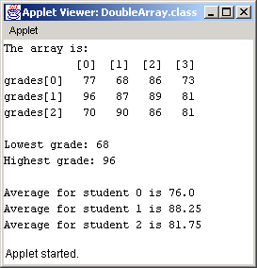
DoubleArray.java

Slide 63
7.10 (Optional Case Study) Thinking About Objects: Collaboration Among Objects
Collaborations
  When objects communicate to accomplish task
    Accomplished by invoking operations (methods)
  One object sends a message to another object
  In 6.17, we extracted verb phrases from problem statement
    Verb phrases exhibit behaviors of classes
    “The elevator resets its button”
      Elevator object sends resetButton message to ElevatorButton object
      Elevator collaborates with ElevatorButton

Slide 64
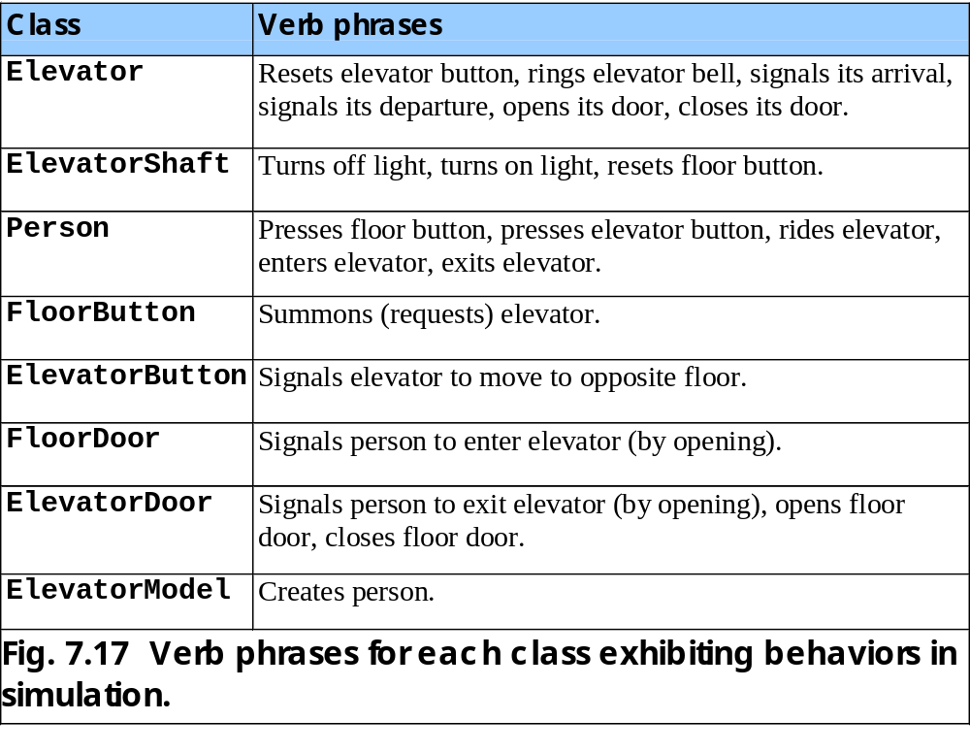

Slide 65
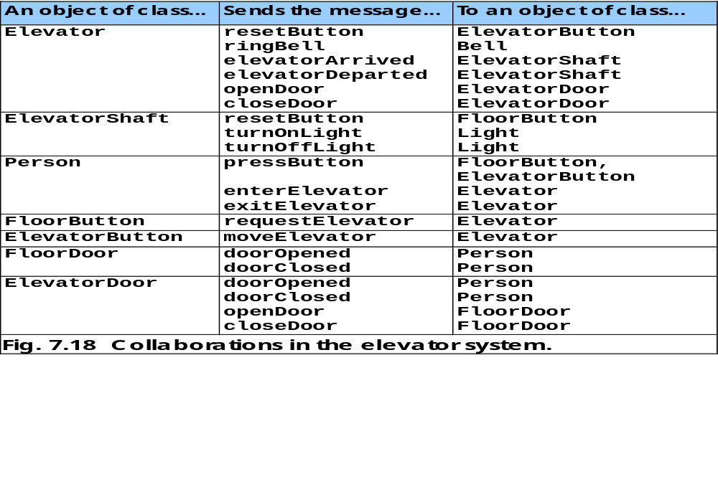

Slide 66
7.10 Thinking About Objects (cont.)
Collaboration diagram (UML)
  Type of interaction diagram
    The other is sequence diagram, discussed in Chapter 15
  Models collaborations in system

Slide 67
7.10 Thinking About Objects (cont.)
Collaboration-diagram notation
  Objects are written in form objectName : ClassName
    Disregard objectName only when concerned about class
  Solid lines connect collaborating objects
  Arrows represent messages
    Indicates direction of collaboration
    Points toward object receiving message
    Can be implemented as a methods (synchronous calls) in Java
  Message names appear next to arrows

Slide 68
pressButton( )
: Person
: FloorButton
Fig. 7.19 Collaboration diagram of a person pressing a floor button.

Slide 69
7.10 Thinking About Objects (cont.)
Collaboration-diagram sequence of messages
  Shows in what order objects send messages
  For diagrams modeling several collaborations
  Progresses in numerical order
    Least to greatest
    Numbering starts with message 1
    Follows a nested structure
      Message 1.1 is first message nested in message 1
      Message 3.2 is the second message nested in message 3
      Message can be passed only when all nested messages from previous message have been passed

Slide 70
3.1.1 : doorOpened( )
3.1 : openDoor( )
: FloorDoor
4.1 : resetButton()
4.2 : turnOnLight( )
: FloorButton
: ElevatorShaft
: Light
4 : elevatorArrived( )
waitingPassenger : Person
ridingPassenger : Person
: Elevator
3.1.1.1 : enterElevator( )
3.2.1 : exitElevator( )
3.2 : doorOpened( )
1 : resetButton( )
2 : ringBell( )
3: openDoor( )
: ElevatorButton
: ElevatorDoor
: Bell
Fig. 7.20 Collaboration diagram for passengers exiting and entering the elevator.

Slide 71
7.10 Thinking About Objects (cont.)
Collaborations in Fig. 7.20
  Message 1
    Elevator sends resetButton to ElevatorButton
  Message 2
    Elevator sends ringBell to Bell
  Message 3
    Elevator sends openDoor to ElevatorDoor
  Message 3.1
    ElevatorDoor sends openDoor to FloorDoor
  Message 3.1.1
    FloorDoor sends doorOpened to waitingPassenger
  Message 3.1.1.1
    waitingPassenger sends enterElevator to Elevator

Slide 72
7.10 Thinking About Objects (cont.)
Collaborations in Fig. 7.20 (continued)
  Message 3.2
    ElevatorDoor sends doorOpened to ridingPassenger
  Message 3.2.1
    ridingPassenger sends exitElevator to Elevator
  Message 4
    Elevator sends elevatorArrived to ElevatorShaft
  Message 4.1
    ElevatorShaft sends resetButton to FloorButton
  Message 4.2
    ElevatorShaft sends turnOnLight to Light

Slide 73
7.10 Thinking About Objects (cont.)
Unfortunately, this design has a problem
  waitingPassenger enters Elevator before ridingPassenger exits
    We fix this in Section 15.12
    We modify this diagram in Section 10.22 (event handling)

